Slide 1



CAAFI 2014
General Meeting
& Expo
Opening Remarks
Steve Csonka,
Executive Director, CAAFI
Michael Huerta
Administrator, FAA
Sharon Pinkerton
Senior Vice President, Legislative and Regulatory Policy, A4A
Michael L. Knotek
Deputy Under Secretary, Office of the U/S for Science and Energy, DOE
Produced by

Slide 2

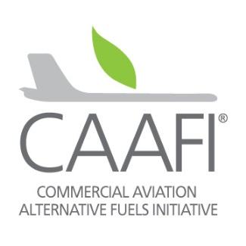
Opening Remarks
Commercial Aviation Alternative Fuels Initiative
Biennial General Meeting, 2014
Takeoff Toward Commercialization
Washington Marriott, Washington, DC
28Jan’14

Slide 3
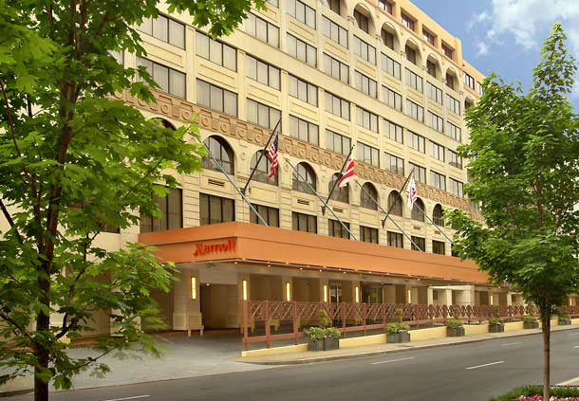
Housekeeping
Team:
  Marriott
  CAAFI
  Kallman Worldwide

Slide 4

Housekeeping
Team:
  Marriott
  CAAFI
  Kallman Worldwide
www.caafi.org

Slide 5

Housekeeping
Team:
  Marriott
  CAAFI
  Kallman Worldwide

Slide 6
Logistics
Event App
  http://eventmobi.com/caafi/
  Agenda
  Contacts
  Bios
  Polling

Slide 7



Welcome
Who we are – CAAFI members & invited guests
  From across the supply chain
  From around the world
  Many first-time attendees
Why we’re here
  Celebrate
  Contemplate
  Collaborate
  Instigate
  Invigorate
Fuel
producers
Airlines,
Military,
Airport orgs.
U.S. States /
State Univ’s
U.S.
Government
Offices
Aircraft,
Engine, Subsystem
OEM’s
15 Countries /
5 Continents

Slide 8
CAAFI - Public/Private Partnership
A reflection of the 22B+ usg US jet fuel “market pull”
An Aviation Industry Coalition Established to Facilitate and Promote the Introduction of Alternative Aviation Fuel
Goal is development of non-petroleum jet fuel production with:
  Equivalent safety & performance (drop-in)
  Comparable cost
  Environmental improvement
  Security of energy supply for aviation
Enables its diverse stakeholders to build relationships, share and collect data, identify resources, and direct research, development and deployment of alternative jet fuels
Synthetic kerosene, primarily from renewable sources

Slide 9
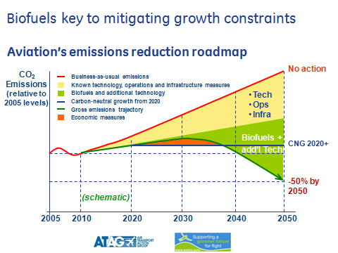
Sustainable Alternative Jet Fuel (SAJF)
Why we care!
  Aviation commitments
  Improving sustainability
Industry alignment on need, as SAJF can bring:
  Carbon relief
  Supply surety, Price stability
  Energy security
  Lower LAQ emissions
  Improved energy mass density
  Minimal infrastructure impact
  Economic opportunity
No near-term viable kerosene alternatives, and …
SAJF works! Challenges, but Lots of Options!

Slide 10
Status Summary:
SAJF is key for meeting industry’s commitments
We know how to make it - broad range of inputs & processes
Modest amounts of SAJF coming online
Working challenges: price, supply-chain, investment
The industry plans to continue their efforts
Potential for acceleration a function of engagement

Slide 11
Opening Remarks
Michael Huerta
    FAA Administrator
Sharon Pinkerton
    A4A SVP Legislative and Regulatory Policy
Dr. Michael Knotek
    Deputy U/S, Office of the U/S for Science and Energy

Slide 12

Where we’re working
CAAFI Facilitation – broad and deep
Feedstock Development
Pathway Development
Sustainability
Price Point
Risk Reduction
Institutional Alignment
Analysis / Tools
Regional Engagement
Int’l Engagement
Research & Development
Certification & Qualification
Tech.
Academia
Industry
States
FAA
Airlines
Commerce
DOE
NASA
Producers
Investors
DOD
EPA
You
USDA
Farmers
Environmental
Business

Slide 13
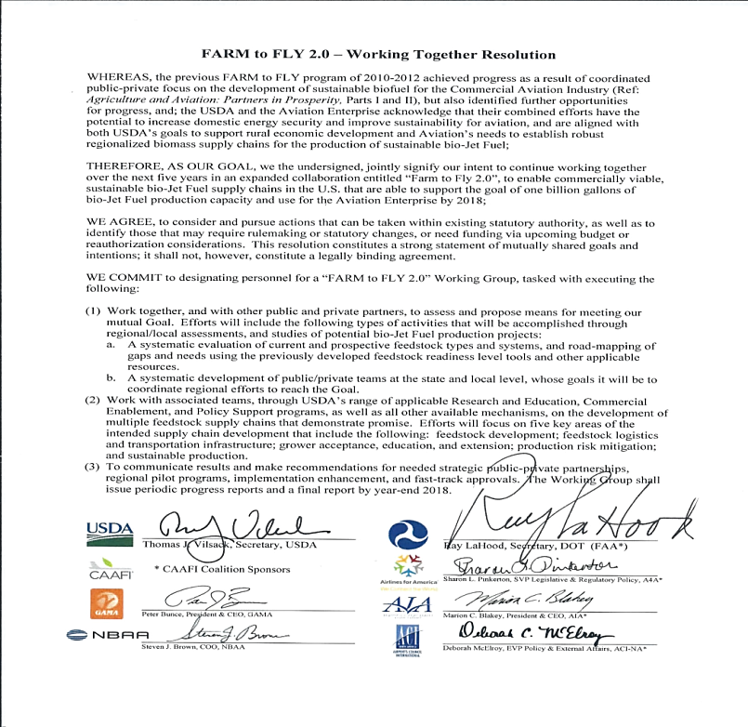

In last 12 months
Farm-to-Fly 2.0
Feedstock Development
Pathway Development
Sustainability
Price Point
Risk Reduction
Institutional Alignment
Analysis / Tools
Regional Engagement
Int’l Engagement
New NIFA CAP: BANR Project in CO on Standing Dead Timber
Efforts continue with other
NIFA AFRI & ARS Biomass Centers
Alaska Airlines and Hawaii BioEnergy pursuit agreement

Slide 14
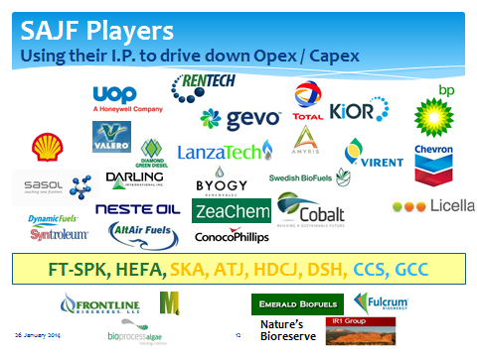
In last 12 months
ASTM Task Forces Progressing,
3 Ballots in this quarter
Feedstock Development
Pathway Development
Sustainability
Price Point
Risk Reduction
Institutional Alignment
Analysis / Tools
Regional Engagement
Int’l Engagement
Additional Focus – Ideas continuing:
CH, APR, HL;
Green Crude Co-Processing,
Diesel Addition ;
Fully synthetic
FAA’s CLEEN 1 and CLEEN 2 Programs enabling production and qualification testing
CAAFI: Critical Challenges,
White Papers, &
SOAP-JET seminars

Slide 15
In last 12 months
Feedstock Development
Pathway Development
Sustainability
Price Point
Risk Reduction
Institutional Alignment
Analysis / Tools
Regional Engagement
Int’l Engagement
CAAFI complements FRL Tools:
Environmental Sustainability O/view & Environmental Progression Tool
NASA initiates in flight emissions testing program
CAAFI pursuing GHG methodology harmonization
EPA Qualifies Alternative Jet Fuel Pathways under the RFS Program

Slide 16
In last 12 months
UAL/AltAir announce Price Competitive DPA
Feedstock Development
Pathway Development
Sustainability
Price Point
Risk Reduction
Institutional Alignment
Analysis / Tools
Regional Engagement
Int’l Engagement
DOE announces intent to focus on Drop-Ins & C.o.P.
UAL issues another RFP
KLM Executes Transatlantic Flight Demos
SkyNRG continues making progress

Slide 17

In last 12 months
Feedstock Development
Pathway Development
Sustainability
Price Point
Risk Reduction
Institutional Alignment
Analysis / Tools
Regional Engagement
Int’l Engagement
USDA/DOE/DOE DPA Phase 1 Awards
DOE Innovative Pilot Awards: 4 Entities

Slide 18
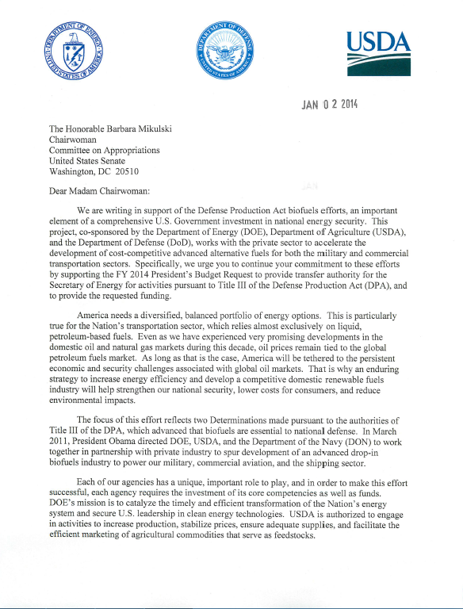
In last 12 months
Feedstock Development
Pathway Development
Sustainability
Price Point
Risk Reduction
Institutional Alignment
Analysis / Tools
Regional Engagement
Int’l Engagement
Initiatives:
DPA, F2F2, Farm-to-Fleet
Coordination Programs:
BRDB, IAWG, NAJFS;
Joint Focus:
Commercial, Military, BizAv;
DLA moving toward JetA

Slide 19
In last 12 months
Feedstock Development
Pathway Development
Sustainability
Price Point
Risk Reduction
Institutional Alignment
Analysis / Tools
Regional Engagement
Int’l Engagement
CAAFI D4054 Users Guide
CAAFI Guidelines on Airline Engagement
Stand-Up of new FAA COE
Several entities looking at siting and transportation optimization tools

Slide 20
In last 12 months
Feedstock Development
Pathway Development
Sustainability
Price Point
Risk Reduction
Institutional Alignment
Analysis / Tools
Regional Engagement
Int’l Engagement
Regional Assessments: MASBI Concluded, ABWG Continues in NW
New evaluation efforts in CT and VT
F2F2 to target Local Initiatives in every state

Slide 21
In last 12 months
New bilateral with Spain joins existing efforts in Brazil, Australia, & Germany
Feedstock Development
Pathway Development
Sustainability
Price Point
Risk Reduction
Institutional Alignment
Analysis / Tools
Regional Engagement
Int’l Engagement
Homegrown activities expanding,
CAAFI working Global Exchange concept
Additional IATA Focal, CAEP WG
Airframers continue supporting airline goals (e.g. SAFUG)
ICAO acknowledges need for Global Approach with Alt Fuels in Basket of Measures

Slide 22
That is real progress!
Now, let’s hear more from
our Government Partners

